Slide 1

Computational Models for Social Network Analysis —mining big social networks (Part I: User modeling)
Jie Tang
Computer Science, Tsinghua University
@WWW’2017

Slide 2

Roadmap
data
User
Tie
Structure
Heterogeneous
Micro
Macro
tie
Dynamic
Influence
- User Modeling
- Demographics
- Social Role
- Social Tie/Link
- Homophily
- Social Influence
- Triad Formation
- Community
- Group Behavior
Big&Big
social
Social Theories
Graph Theories
BIG Networks

Slide 3
Roadmap
data
User
Tie
Structure
Heterogeneous
Micro
Macro
tie
Dynamic
Influence
- User Modeling
- Demographics
- Social Role
- Social Tie/Link
- Homophily
- Social Influence
- Triad Formation
- Community
- Group Behavior
Big&Big
social
Social Theories
Graph Theories
BIG Network

Slide 4



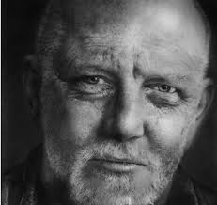
User Modeling—Demographics and social strategies
Did you know: As of 2014, there are 7.3 billion mobile users.
Users average 22 calls, 23 messages, and 110 status checks per day.
male
Less friends
More stable
female
Young
Senior
have
2x more social connections
4x more opposite-gender circles
than
[1] Yuxiao Dong, Yang Yang, Jie Tang, Yang Yang, Nitesh V. Chawla. Inferring User Demographics and Social Strategies in Mobile Social Networks. KDD’14, pages 15-24. (Report by United Nations)

Slide 6
Our Data
Read-world large mobile network data^{[1]}
An anonymous country
No communication content.
Aug. 2008 – Sep. 2008.
> 7 million mobile users + demographic information.
> 1 billion communication records (call and message).
Two networks:
Network | #nodes | #edges
CALL | 7,440,123 | 32,445,941
SMS | 4,505,958 | 10,913,601
[1] J.P. Onnela, J. Saramaki, J. Hyvonen, G. Szabo, D. Lazer, K. Kaski, J. Kertesz, A. L. Barabasi. Structure and tie strengths in mobile communication networks. PNAS 2007.

Slide 7
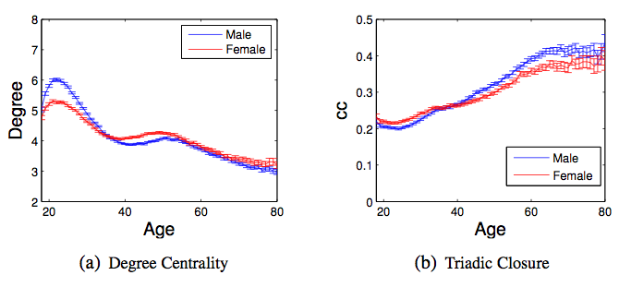
Ego Network
Peak at 22 years old
Valley and reversion at 38-40 years old
Correlations between user demographics and network properties.
Young people are very active in broadening their social circles, while seniors have the tendency to maintain small but close connections.

Slide 8
Demographic Homophily
People tend to communicate with others of both similar gender and age, i.e., demographic homophily.

Slide 9
Social Triad
People expand both same-gender and opposite-gender social groups during the dating and reproductively active period.

Slide 10
Social Triad
vs.
People’s social attention to opposite-gender groups quickly disappears, and the insistence on same-gender social groups lasts for a lifetime.

Slide 11
Social Tie Strength
vs.
Interactions between two young opposite-gender people are much more frequent than those between young same-gender people.
Notes:
Color: #calls / per month

Slide 12
Social Tie Strength
vs.
When people become mature, reversely, same-gender interactions are more frequent than those between opposite-gender users.

Slide 13
Social Tie Strength
vs.
Cross-generation interactions between two females are more frequent than those between two males or one male and one female.

Slide 14
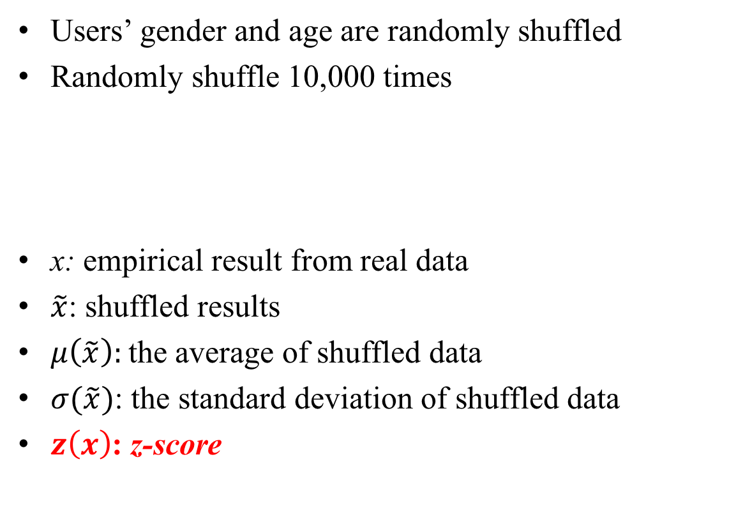

Null Model
Users’ gender and age are randomly shuffled
Randomly shuffle 10,000 times
x: empirical result from real data
$\tilde{x}$: shuffled results
$μ\left(\tilde{x}\right):$the average of shuffled data
$σ(\tilde{x})$: the standard deviation of shuffled data
$z\left(x\right)$: z-score
$$z\left(x\right)= \frac{x−μ(\tilde{x})}{σ(\tilde{x})}$$

Slide 15
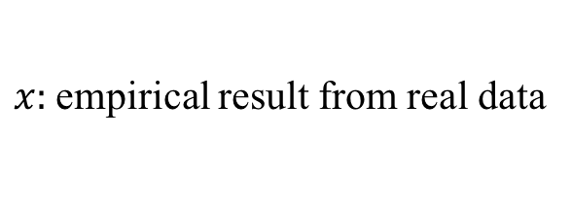
Social Triad
$x:$empirical result from real data

Slide 16
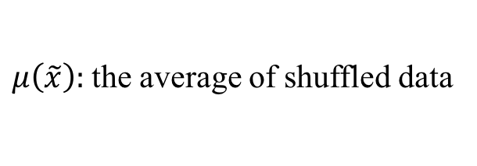
Social Triad
$μ\left(\tilde{x}\right):$the average of shuffled data

Slide 17

Social Triad
$z\left(x\right)$: z-score
|z-score| > 3.3 (p < 0.001) is considered to be extremely statistically significant.

Slide 18
User Modeling—social strategies across the lifespan
male
Less friends
More stable
female
Young
Senior
have
2x more social connections
4x more opposite-gender circles
than
more friends
same-gender
fewer friends
only same-gender
opposite-gender
closed circles
[1] Yuxiao Dong, Yang Yang, Jie Tang, Yang Yang, Nitesh V. Chawla. Inferring User Demographics and Social Strategies in Mobile Social Networks. KDD’14, pages 15-24. (Report by United Nations)

Slide 19
Demographic Prediction
Infer Users’ Gender Y and Age Z Separately.
Model correlations between gender Y and attributes X;
Model correlations between age Z and attributes X;
bag of labels
gender
features
age
features
Y
X
Z
X
bag of instances
bag of instances
P(Y | X)
P(Z | X)

Slide 20
Demographic Prediction
Infer Users’ Gender Y and Age Z Simultaneously.
Model correlations between gender Y and attributes X, Network G and Y;
Model correlations between age Z and attributes X, Network G and Z;
Model interrelations between Y and Z;
gender
age
features
Y
Z
X
P(Y, Z | G, X)

Slide 21
Demographic Prediction
Infer Users’ Gender Y and Age Z Simultaneously.
Model correlations between gender Y and attributes X, Network G and Y;
Model correlations between age Z and attributes X, Network G and Z;
Model interrelations between Y and Z;
Input:
G = (V^{L}, V^{U}, E, Y^{L}, Z^{L}), X
Output:
f(G, X)→(Y^{U}, Z^{U})
Gender Y:
Male (55%) / Female (45%)
Age Z:
Young (18-24) / Young-Adult (25-34) / Middle-Age (35-49) / Senior (>49)

Slide 22

WhoAmI Method
Modeling social strategies on social triad
Modeling social strategies on social tie
Triadic factor h()
Dyadic factor g()
Modeling interrelations
between gender and age
Random variable Z: Age
Random variable Y: Gender
Attribute factor f()
Modeling social strategies
on ego networks
Joint Distribution:
Code is available at: http://arnetminer.org/demographic

Slide 23
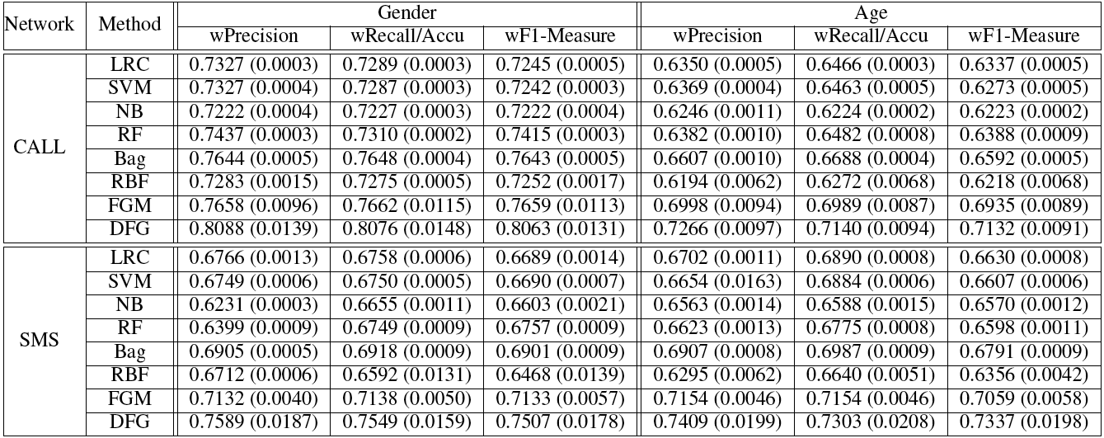
WhoAmI: Experiments
Data: active users (#contacts >=5 in two months)
>1.09 million users in CALL
>304 thousand users in SMS
50% as training data
50% as test data

Slide 24
WhoAmI: Experiments
Baselines:
LRC: Logistic Regression
SVM: Support Vector Machine
NB: Naïve Bayes
RF: Random Forest
BAG: Bagged Decision Tree
RBF: Gaussian Radial Basis NN
FGM: Factor Graph Model
DFG (WhoAmI)
Evaluation Metrics:
Weighted Precision
Weighted Recall
Weighted F1 Measure
Accuracy

Slide 25
Results

Slide 26
Summary
Predictability of User Demographic Profiles
The proposed WhoAmI (DFG) outperforms baselines by up to 10% in terms of F1-Meausre.
We can infer 80% of users’ gender from the CALL network
We can infer 73% of users’ age from the SMS network
The phone call behavior reveals more user gender than text messaging
The text messaging behavior reveals more user age than phone call

Slide 27
Generalization
Can we generalize the method to other networks?

Slide 28
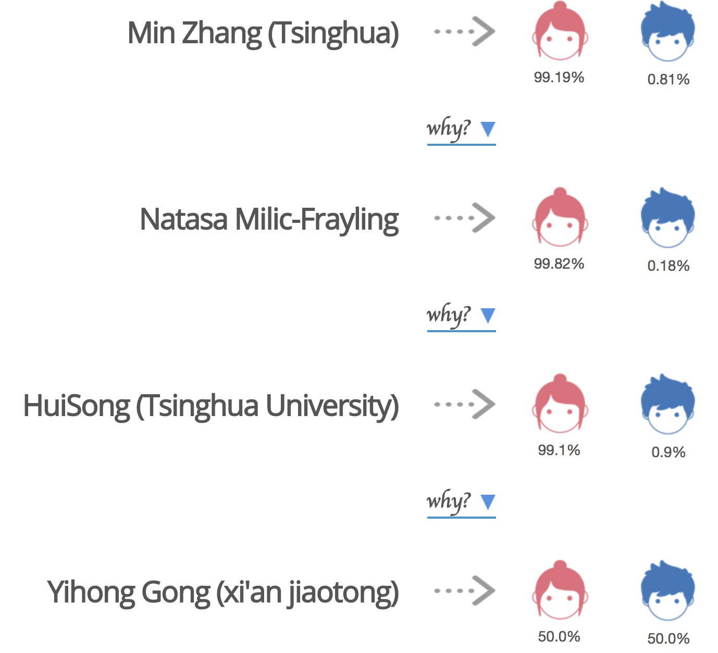
Inferring Gender in AMiner
https://aminer.org/gender
An interesting API
Our Method
FGNL is a baseline method
[1] Xiaotao Gu, Hong Yang, Jie Tang, and Jing Zhang. Web User Profiling using Data Redundancy. ASONAM'16. (Best Student Paper Runner-up)

Slide 29
Addressing User Modeling as an Integration problem —Beyond extraction/prediction

Slide 30
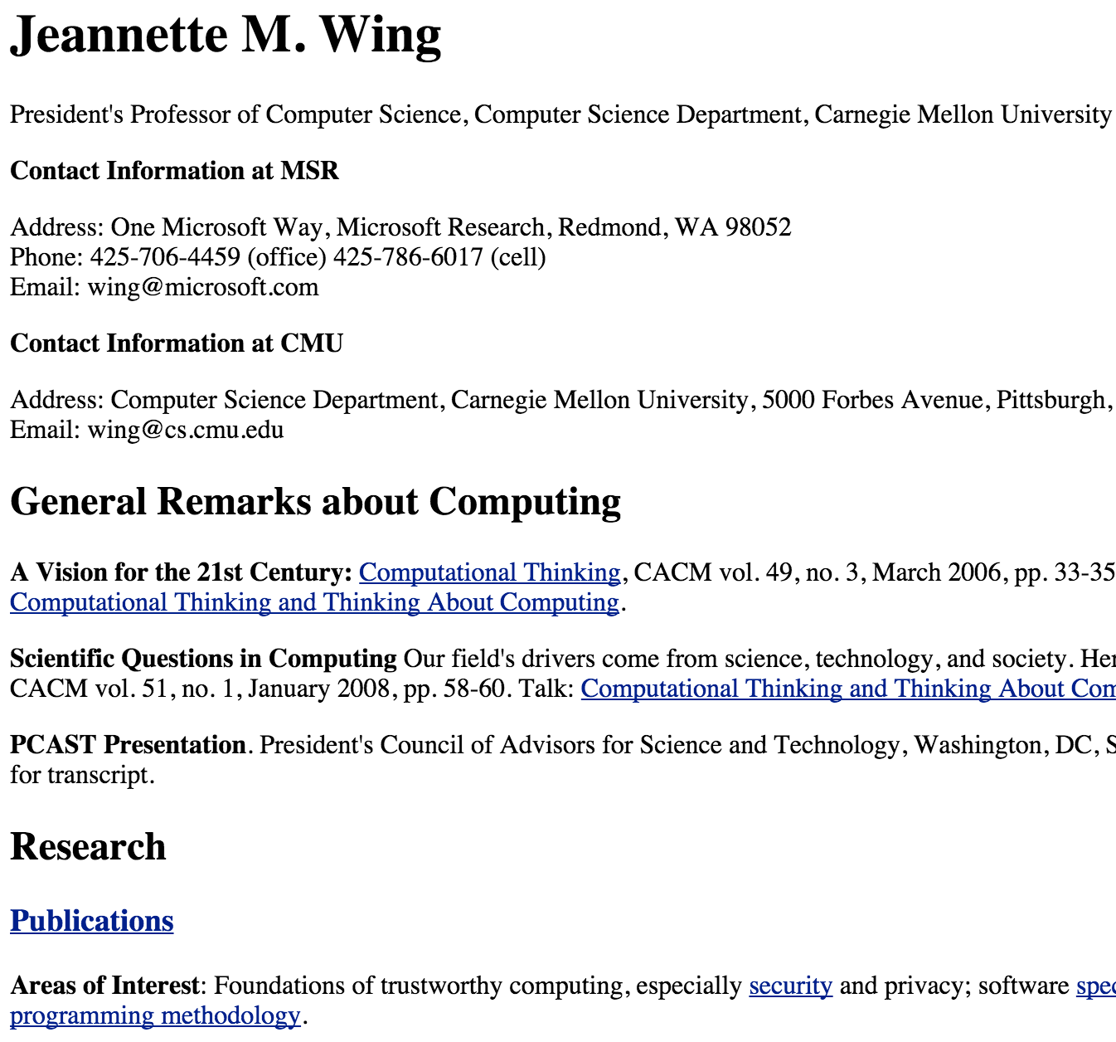
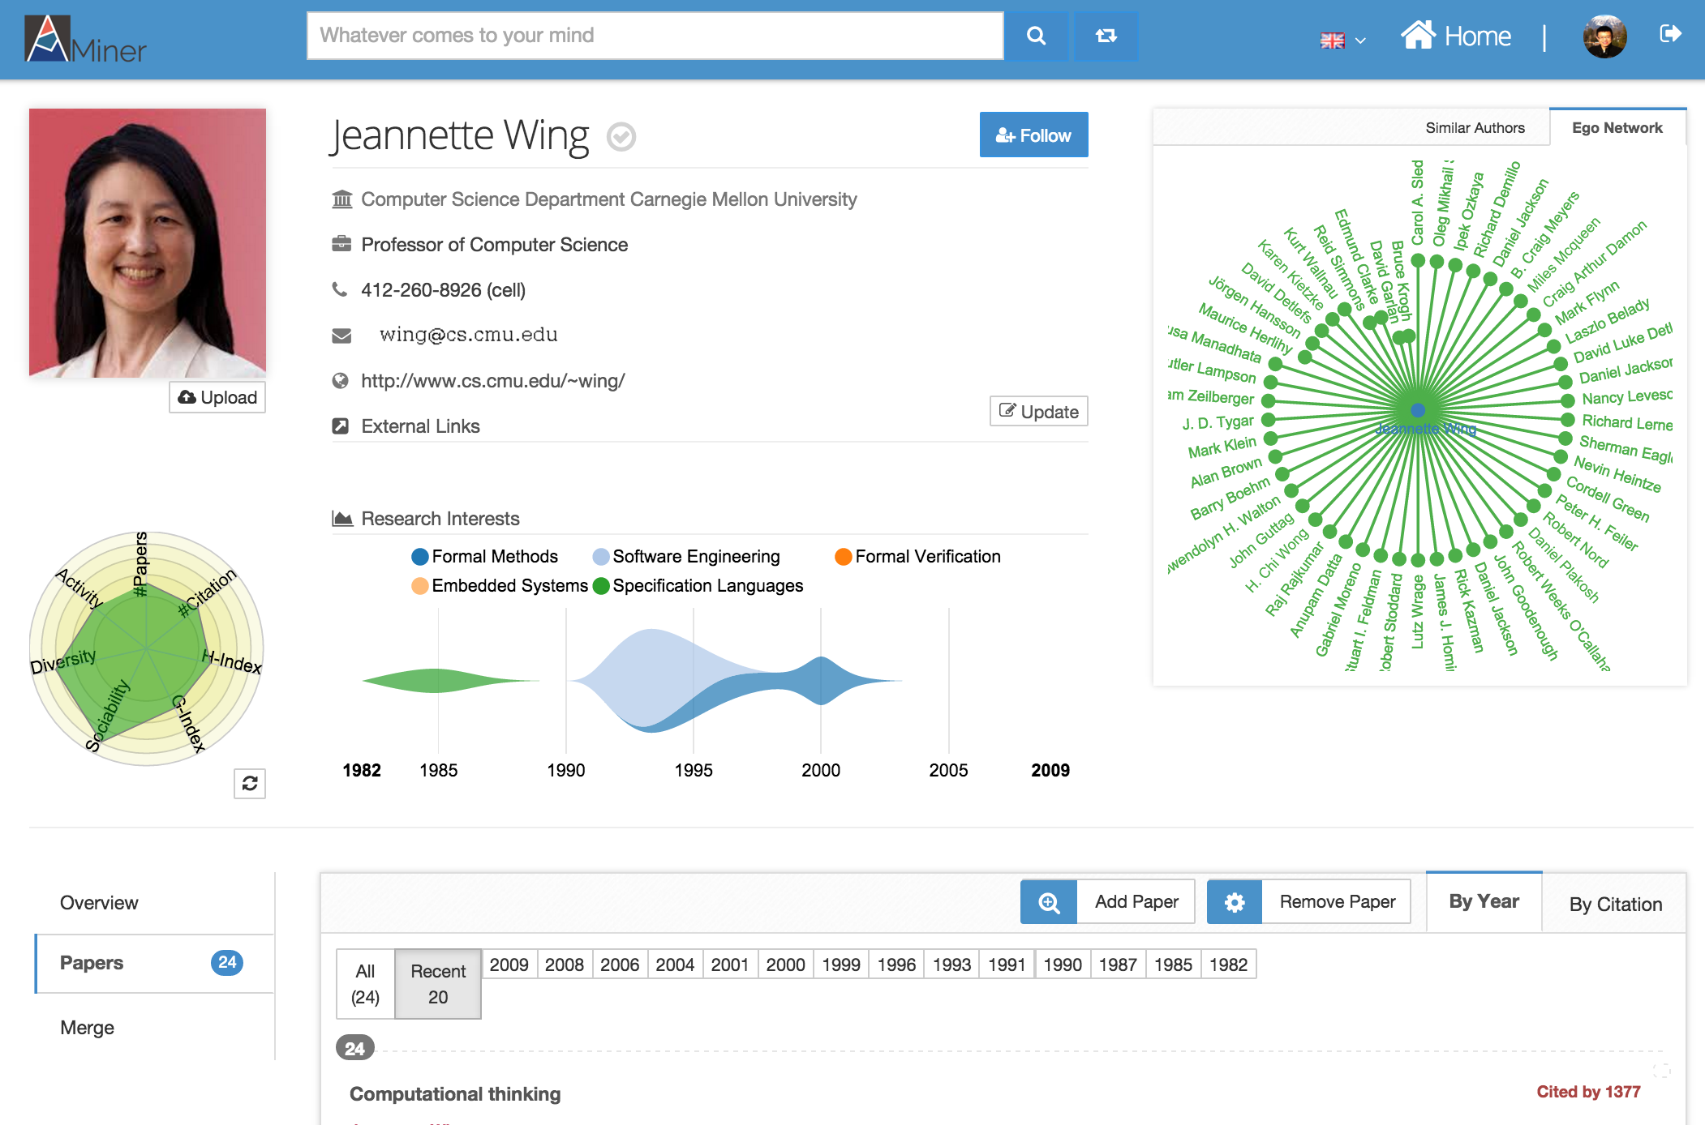
Model user profiles
Homepage
A common method: Finding the homepage (relevant pages) and extract profile attributes.
However, the extracted information is correct but not precise…

Slide 31
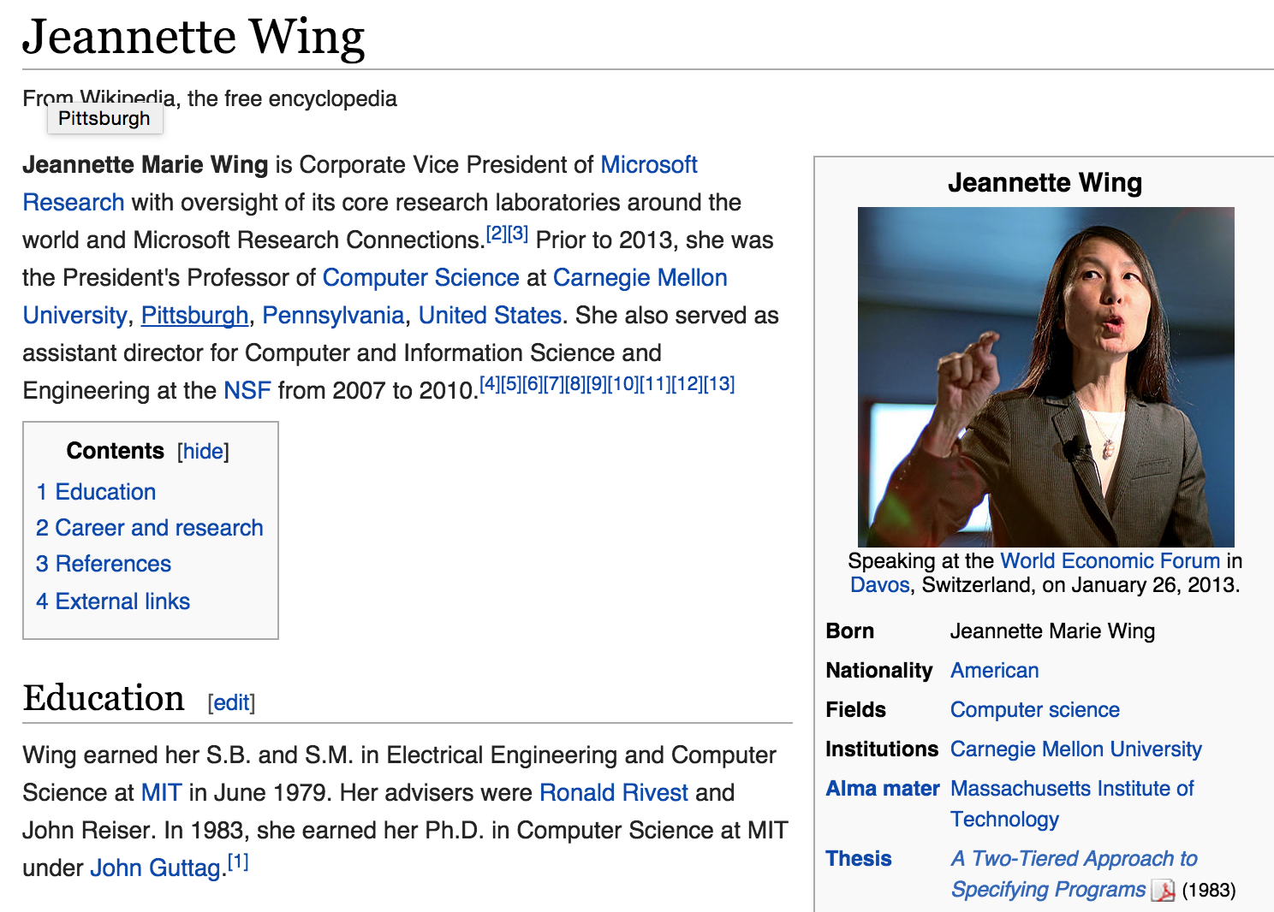
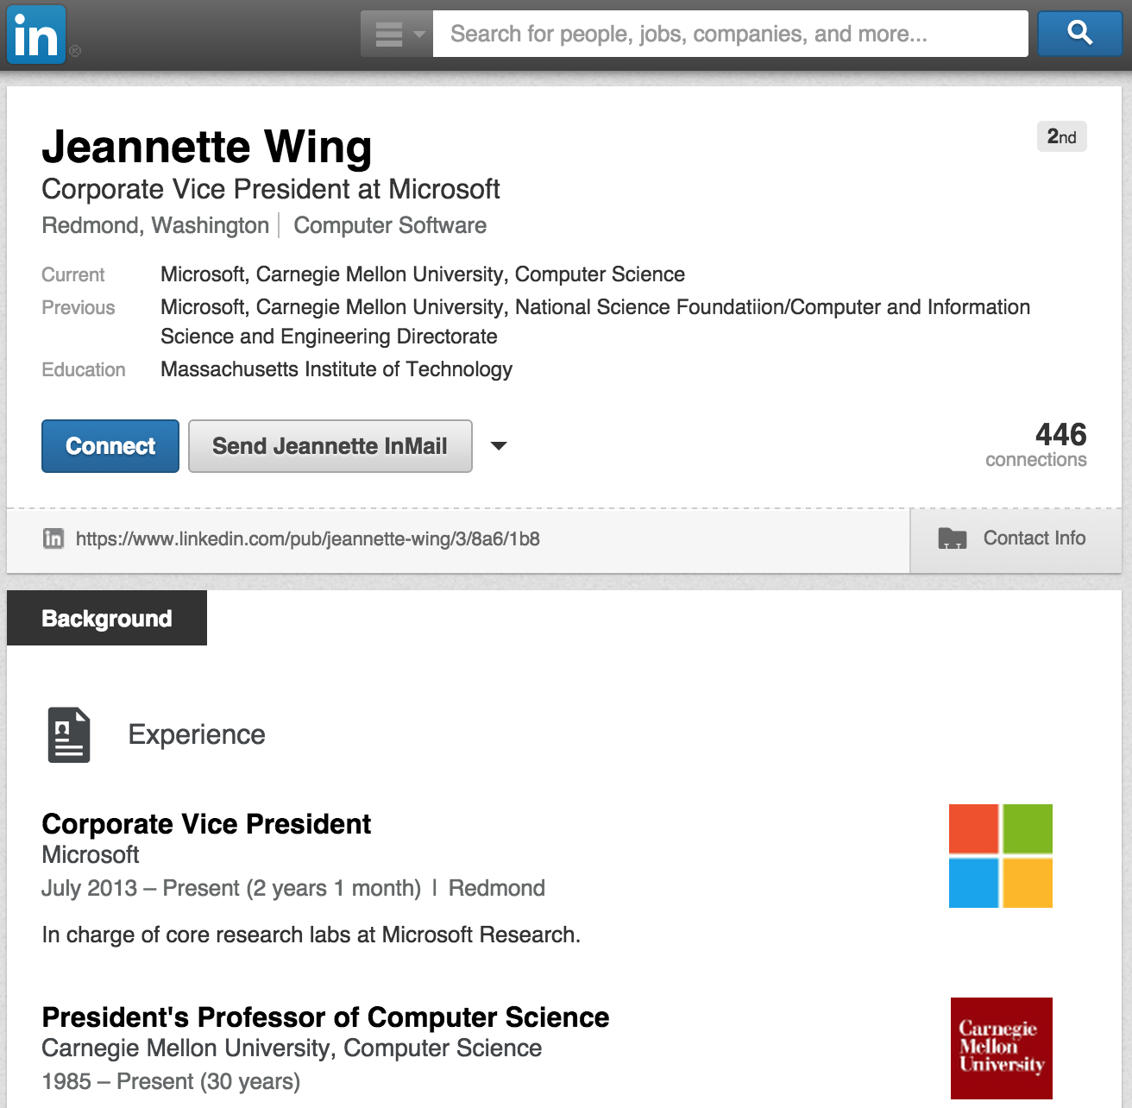
User profiles are distributed…
Some information goes out of date…
Many information is semi-structured—the key is not extraction.
Wikipedia
Homepage
LinkedIn
AMiner

Slide 32
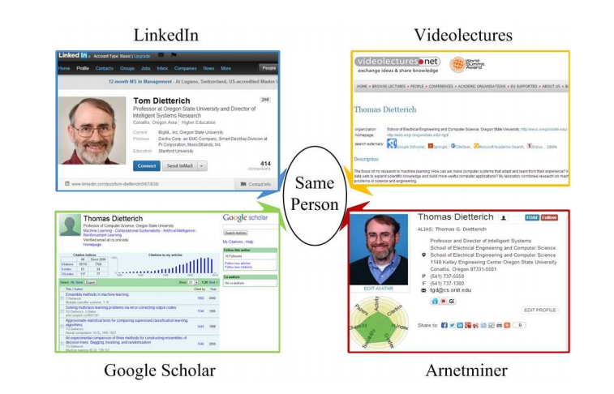

Connecting Multiple Networks
Identifying users from multiple heterogeneous networks and integrating semantics from the different networks together.
LinkedIn
Wikipedia
Jeannette Wing
Jeannette Wing
Google Scholar
AMiner
Notes:
is a fundamental issue in many applications

Slide 33
Considering the networks…

Slide 34

Local vs. Global consistency
Given three networks,
AMiner

Slide 35
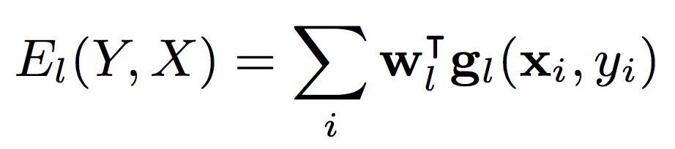
Local vs. Global consistency
Local matching: matching users by profiles
AMiner
Pairwise similarity features
Username similarity and uniqueness
Profile content similarity
Ego network similarity
Social status
Local consistency
Energy function

Slide 36
Local vs. Global consistency
Network matching: matching users’ ego networks
AMiner
Network matching
Local consistency
Encourage “neighborhood-preserving matching”

Slide 37
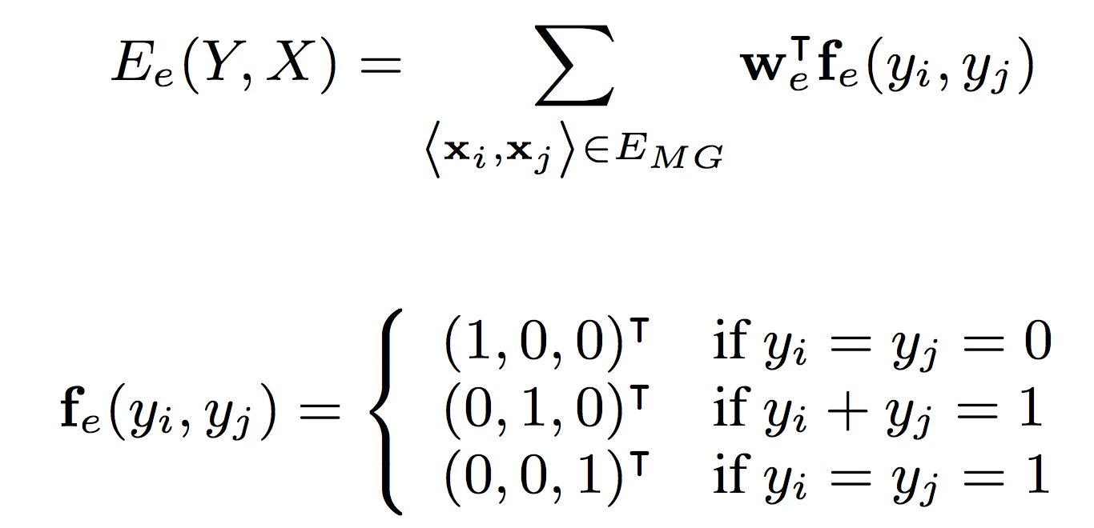
Network Matching
Network matching: matching users’ ego networks
Input networks
Matching graph
Energy function

Slide 38
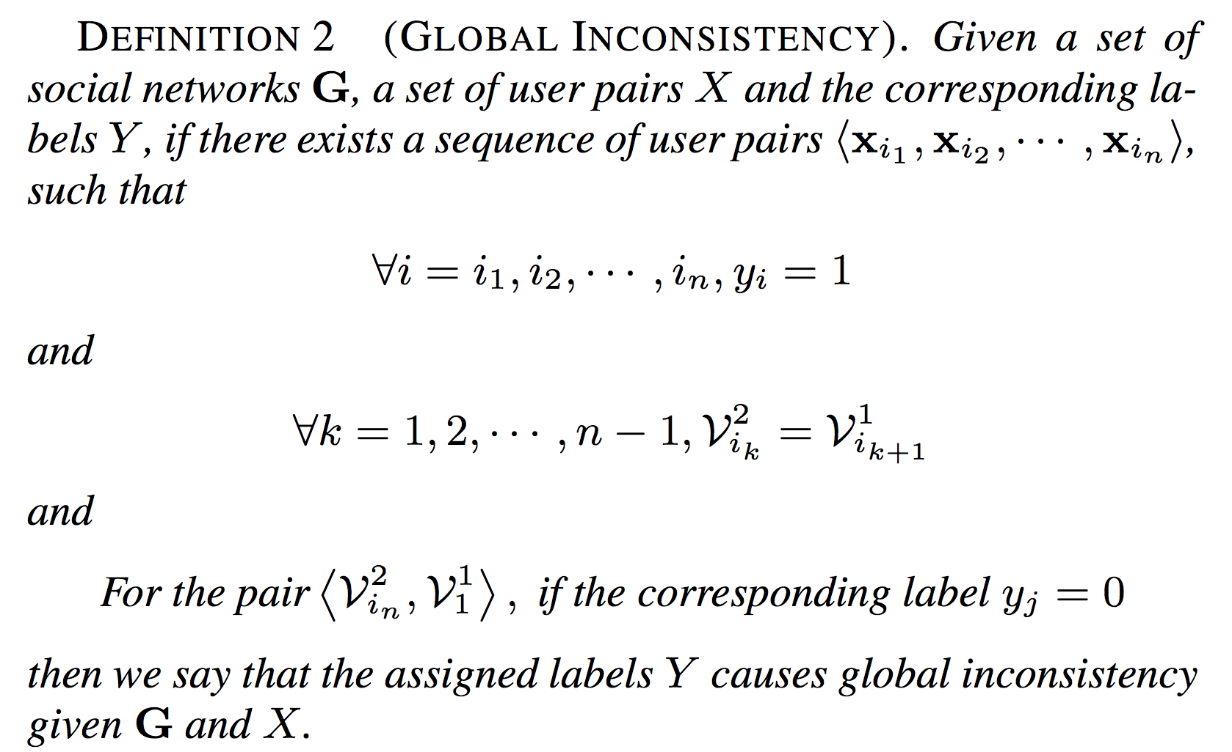
Local vs. Global consistency
Global consistency: matching users by avoiding global inconsistency
AMiner
Network matching
Local consistency
Global inconsistency
Avoid “global inconsistency”

Slide 39
Local vs. Global consistency
Global consistency: matching users by avoiding global inconsistency
AMiner
Network matching
Local consistency
x
Global inconsistency
x
x
x
x
x

Slide 40



Local vs. Global consistency
Global consistency: matching users by avoiding global inconsistency
AMiner
Network matching
Local consistency
x
Inconsistent!
Global inconsistency
x
x
x
x
x

Slide 41
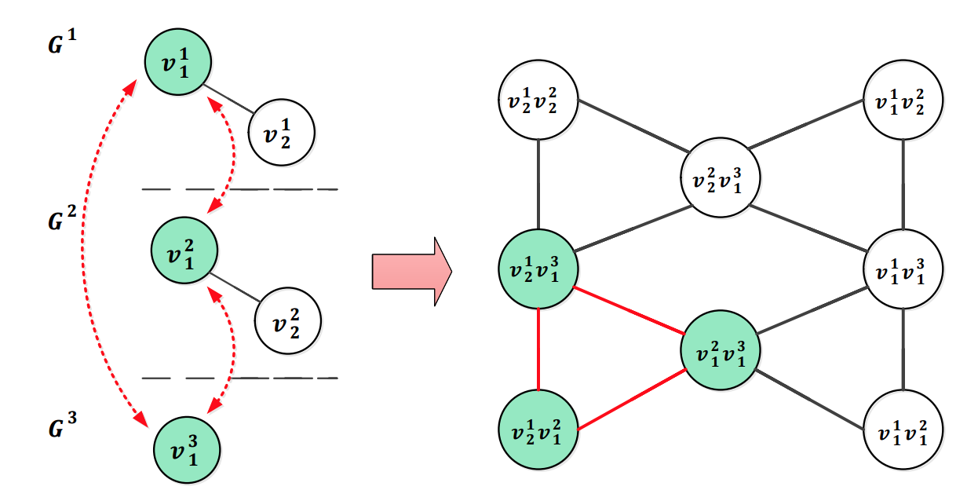
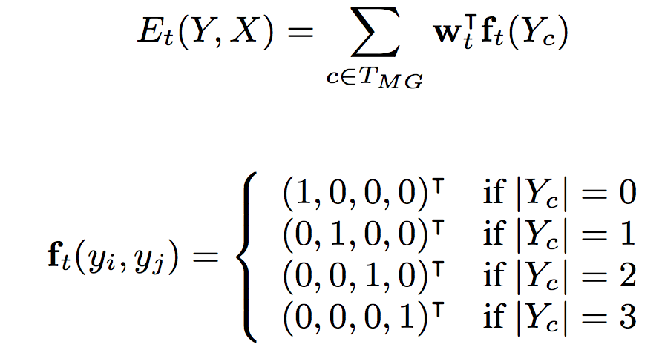
Avoid global inconsistency
Input networks
Matching graph
Energy function

Slide 42
COSNET: Connecting Social Networks with Local and Global Consistency
Input: G={G¹, G², …, G^{m}}, with G^{k}=(V^{k}, E^{k}, R^{k})
Formalization: X={x_{i}}, all possible pairwise matchings and each corresponds to
COSNET: an energy-based model
[1] Yutao Zhang, Jie Tang, Zhilin Yang, Jian Pei, and Philip Yu. COSNET: Connecting Heterogeneous Social Networks with Local and Global Consistency. KDD’15, page 1485-1494.

Slide 43
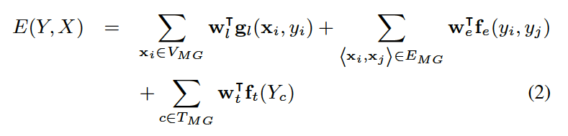
Model Construction
Objective function by combining all the energy functions

Slide 44
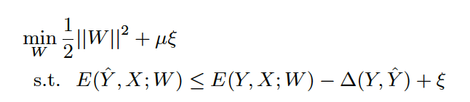
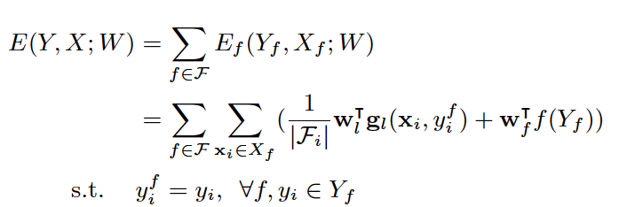
Model Learning
Max-margin learning
As the original problem is intractable, we use Lagrangian relaxation to decompose the original objective function into a set of easy-to-solve sub-problems

Slide 45
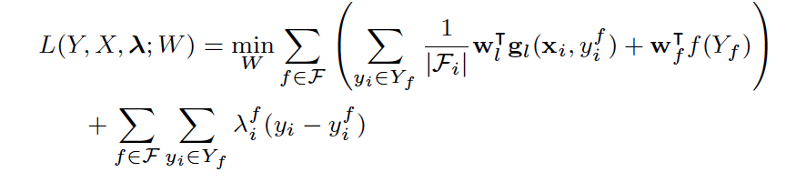
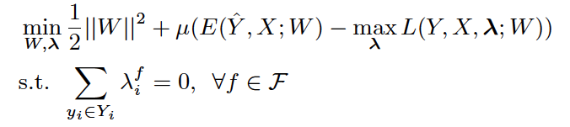
Model Learning (cont.)
Dual decomposition
This provides a lower bound to the original function
The resulting objective function is convex and non-differentiable, and can be solved by projected sub-gradient method

Slide 46
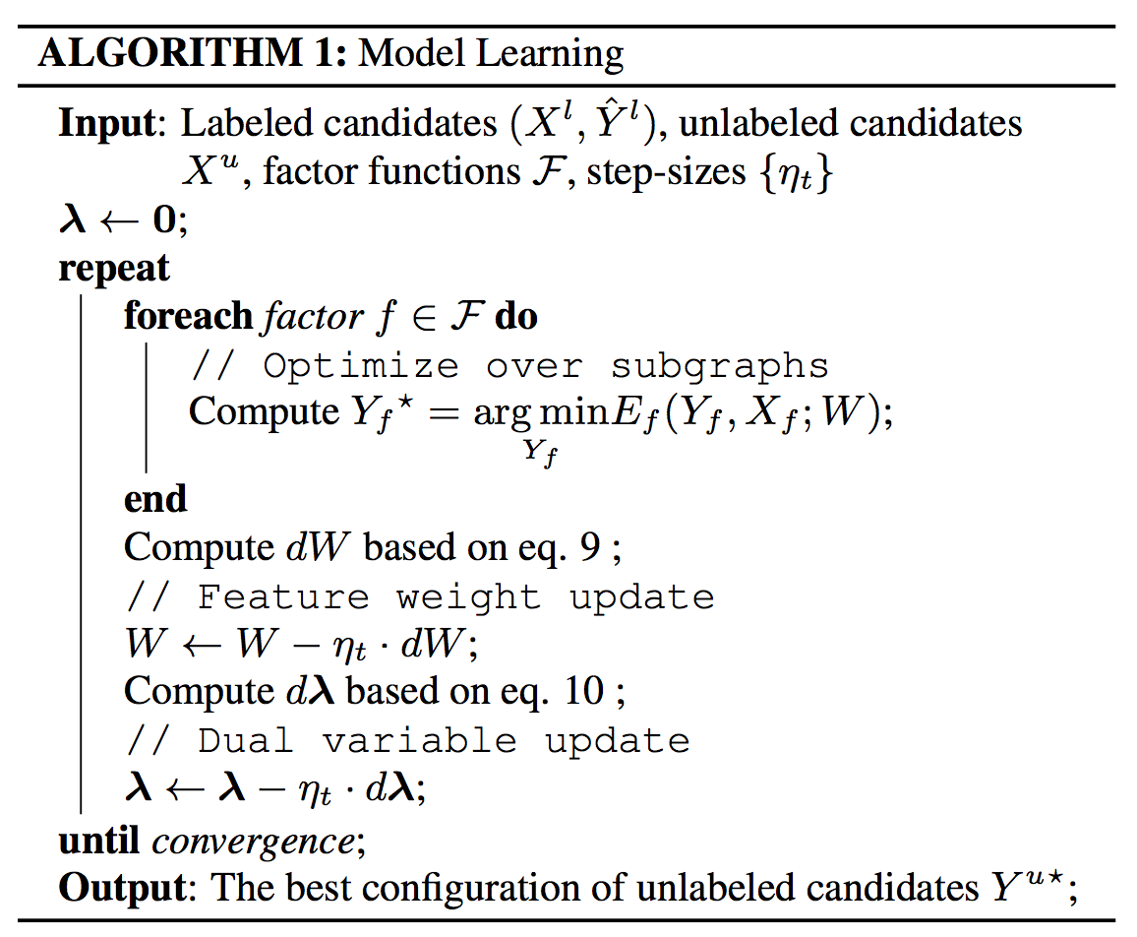
Model Learning (cont.)

Slide 47
Results

Slide 48
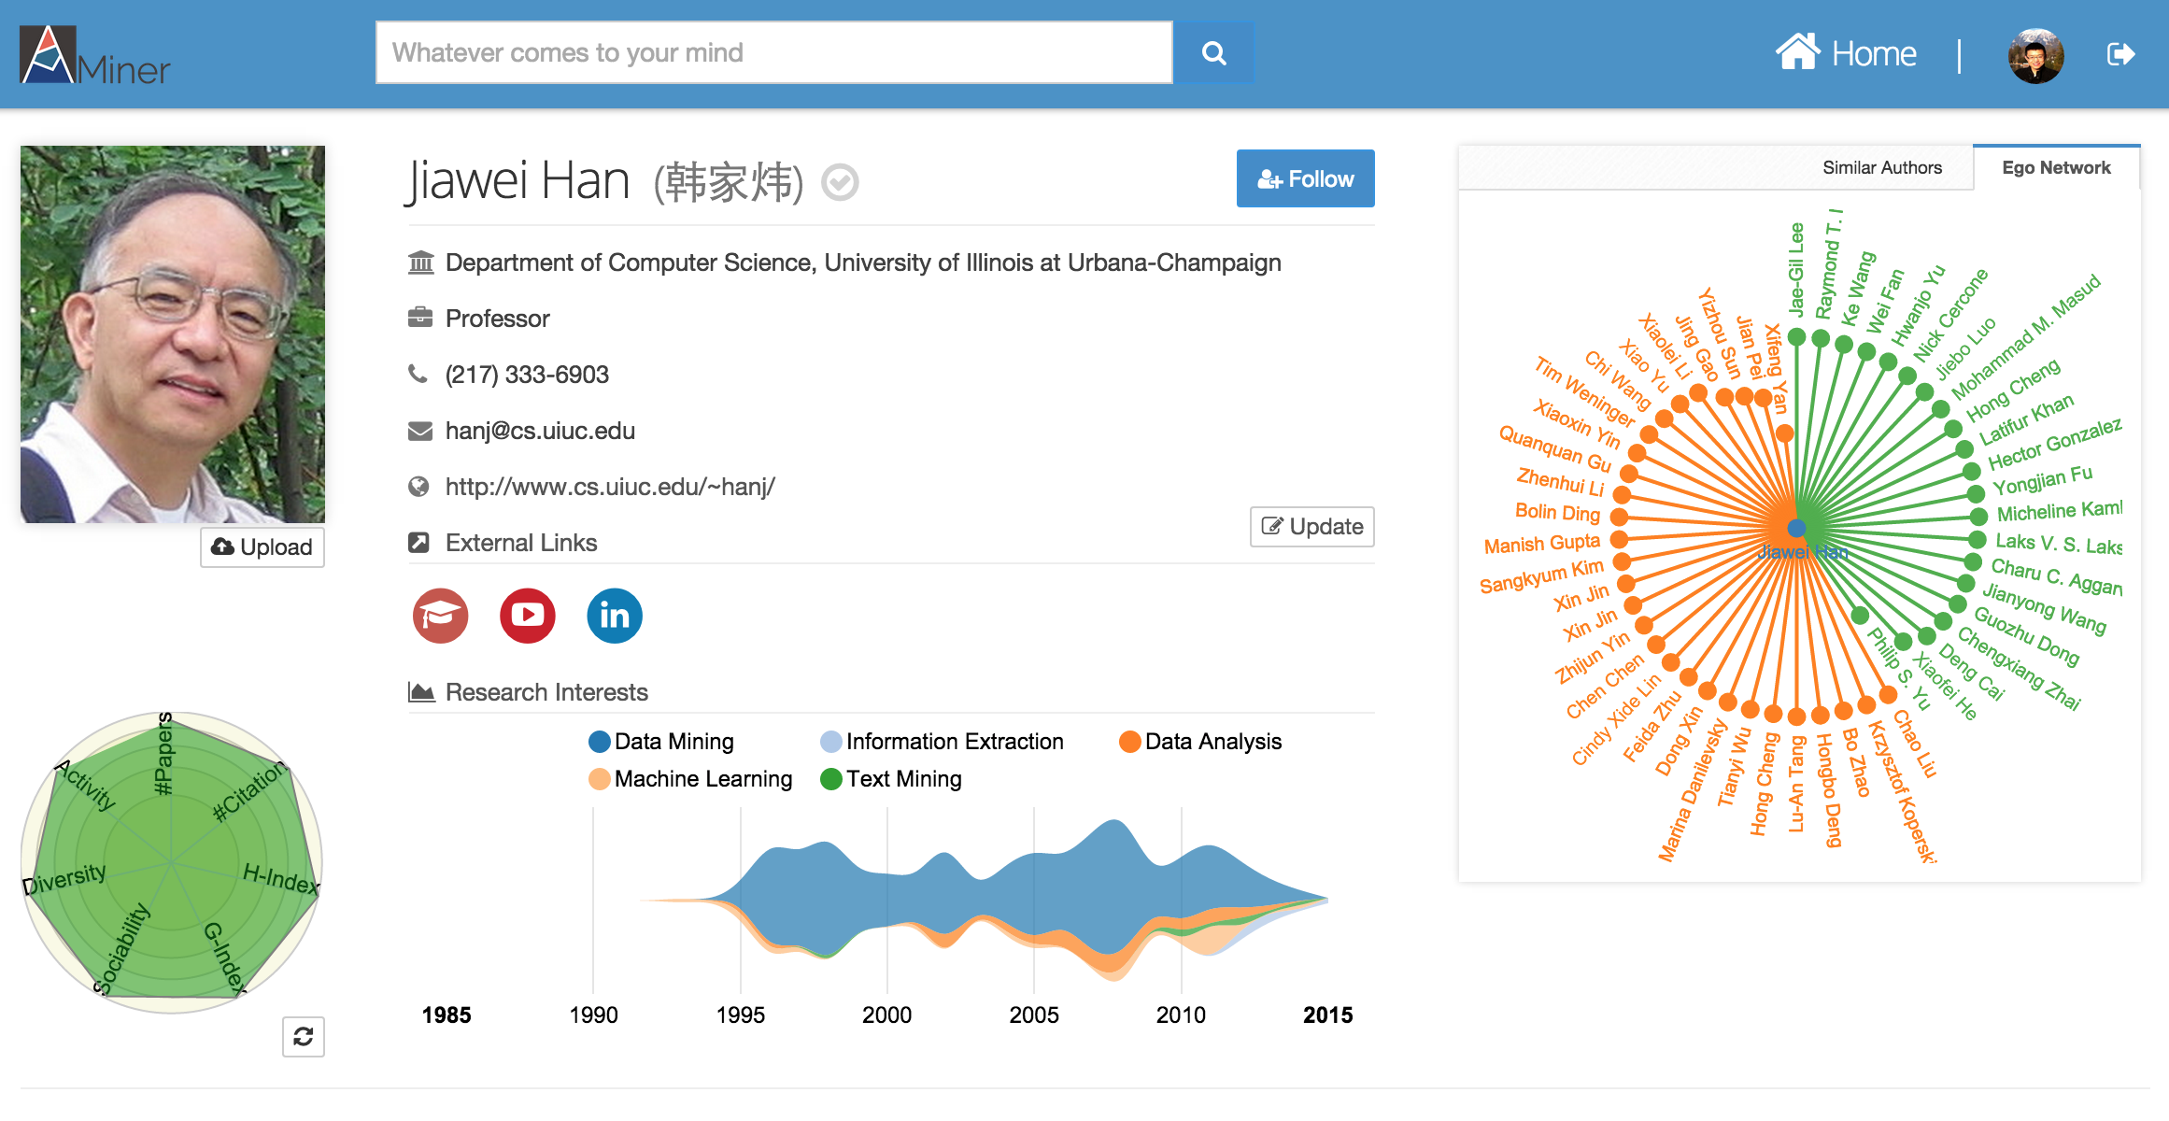
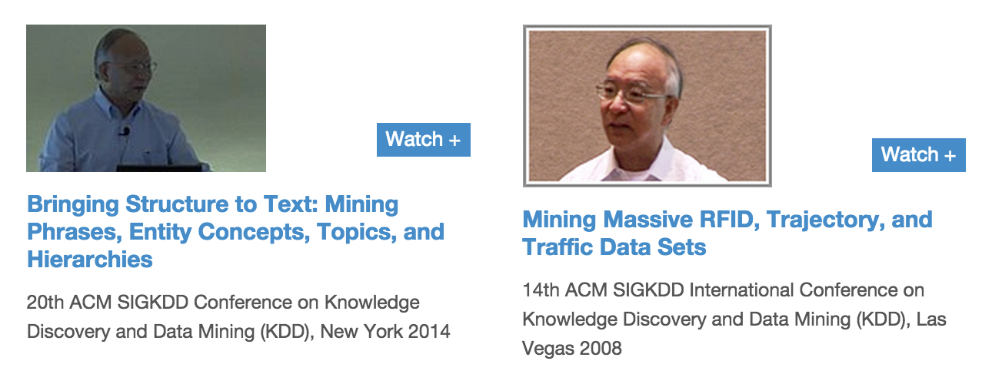
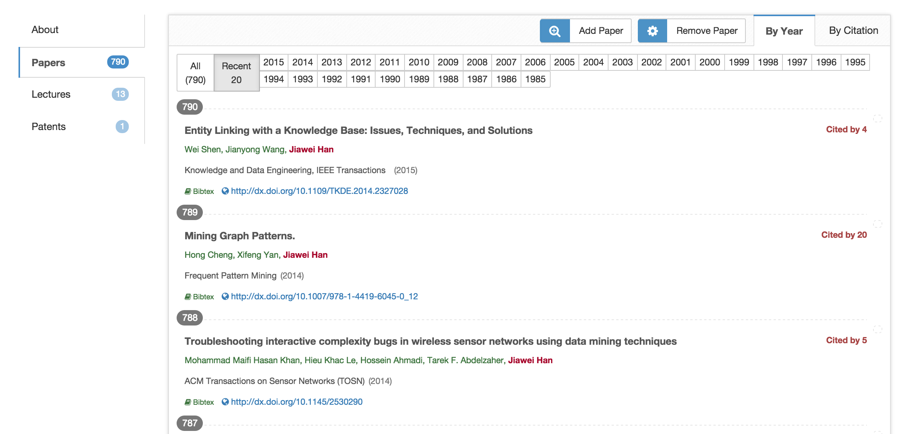
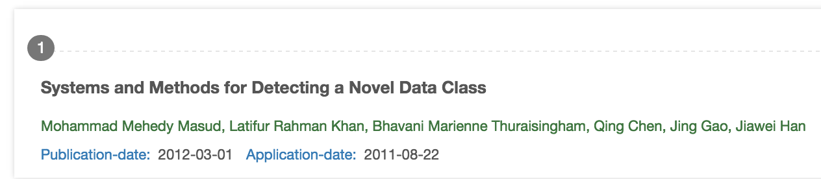
Researcher Profile
LinkedIn
VideoLectures
USPTO

Slide 49
Data Sets
Dataset | Network | #Users | #Relationships
SNS | Twitter | 40,171,624 | 1,468,365,182
 | LiveJournal | 3,017,286 | 87,037,567
 | Flickr | 215,495 | 9,114,557
 | Last.fm | 136,420 | 1,685,524
 | MySpace | 854,498 | 6,489,736
Academia | LinkedIn | 2,985,414 | 25,965,384
 | ArnetMiner | 1,053,188 | 3,916,907
 | VideoLectures | 11,178 | 786,353
Ground Truth
Thank Shlomo Berkovsky, Terence Chen, and Dali Kaafar for sharing the SNS data with ground-truth [28].
In Academia, we chose 10,000 authors from ArnetMiner who were connected with LinkedIn profiles and VideoLectures profiles as the ground truth.
Data&codes: https://aminer.org/cosnet

Slide 50
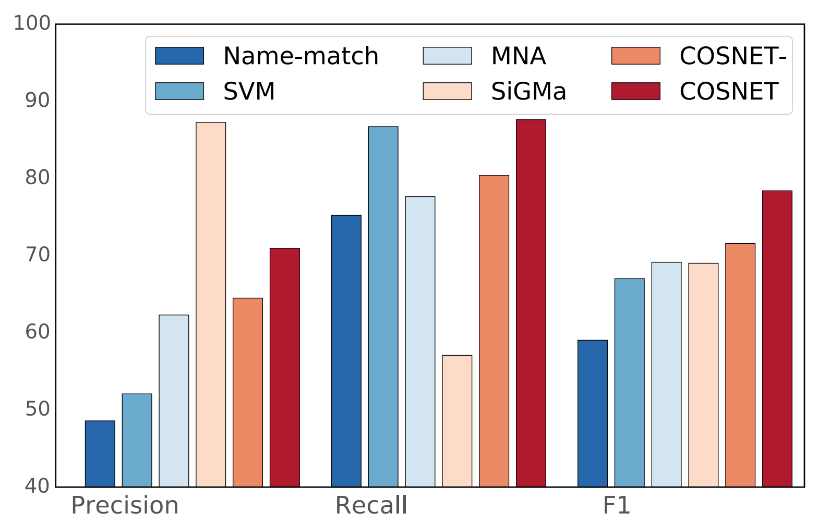
Connecting AMiner with …
LinkedIn and VideoLectures
Name-match: match name only;
SVM: use classifier to identify the same user;
MNA: an optimization method;
SiGMa: local propagation;
COSNET: our method;
COSNET-: w/o global consistency.
Data&codes: https://aminer.org/cosnet

Slide 51
Connecting Social Media Sites
Twitter, LiveJournal, Last.fm, Flickr, MySpace
Name-match: match name only;
SVM: use classifier to identify the same user;
MNA: an optimization method;
SiGMa: local propagation;
COSNET: our method;
COSNET-: w/o global consistency.
Data&codes: https://aminer.org/cosnet

Slide 52
Effects of Global Consistency
COSNET-: w/o global consistency.
Academia Collection
SNS Collection

Slide 53
Big Network Analysis
data
User
Tie
Topology
Heterogeneous
Micro
Macro
tie
Dynamic
Influence
- User Modeling
- Demographics
- Social Role
- Social Tie/Link
- Homophily
- Social Influence
- Triad Formation
- Community
- Group Behavior
Big&Big
social
Social Theories
Graph Theories
BIG Network

Slide 54
Thank you！
Collaborators: John Hopcroft, Jon Kleinberg, Chenhao Tan (Cornell)
Jiawei Han (UIUC), Philip Yu (UIC)
Jian Pei (SFU), Hanghang Tong (ASU)
Tiancheng Lou (Google&Baidu), Jimeng Sun (GIT)
Wei Chen, Ming Zhou, Long Jiang, Chi Wang, Yuxiao Dong (Microsoft)
Yutao Zhang, Jing Zhang, Zhanpeng Fang, Zi Yang, Sen Wu, etc. (THU)
Jie Tang, KEG, Tsinghua U, http://keg.cs.tsinghua.edu.cn/jietang
Download all data & Codes, http://arnetminer.org/data http://arnetminer.org/data-sna

